Slide 1
Parent Writing Workshop
Paul L. Dunbar Arts PRE-K 8 Enrichment Academy

Slide 2
School Priority
Writing a response to a grade level text

Slide 3
Writing for Understanding
At Paul L. Dunbar Pre K-8 Arts-Enrichment Academy, we have adopted strategies from the Vermont Writing Collaborative.
Writing for Understanding is based on the premise that writing is ultimately about meaning.
We believe that students need to understand the topic they are writing about deeply in order to use appropriate writing structures and tools effectively.
Deep understanding ultimately helps students internalize new writing techniques and then transfer learning to their next writing opportunities.

Slide 4
Students are Graded using OST/RUBRIC

Slide 5
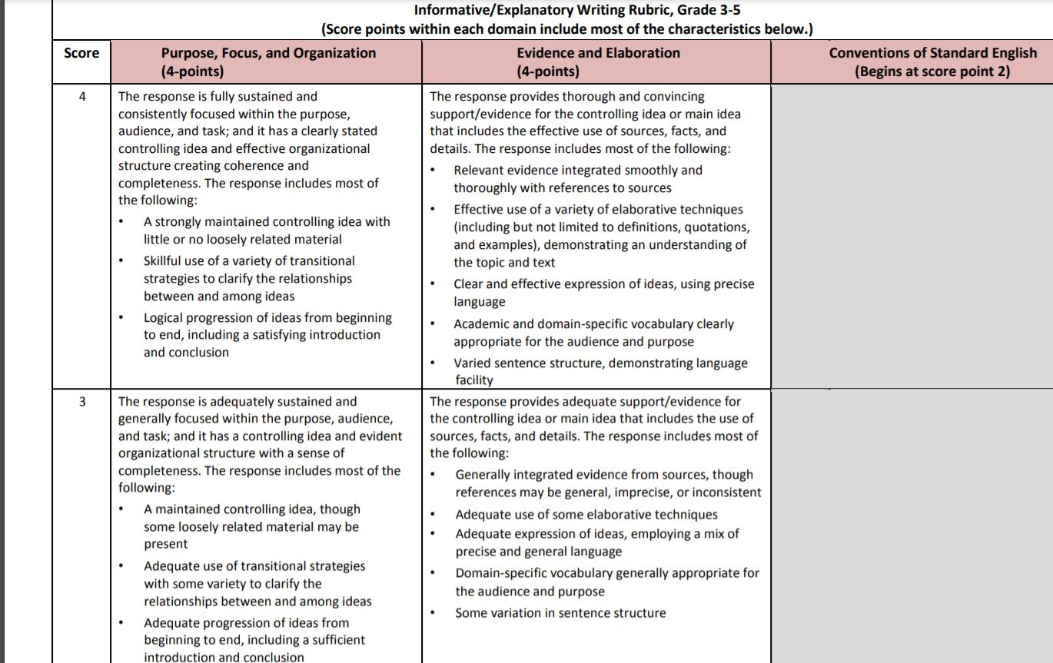

Slide 6
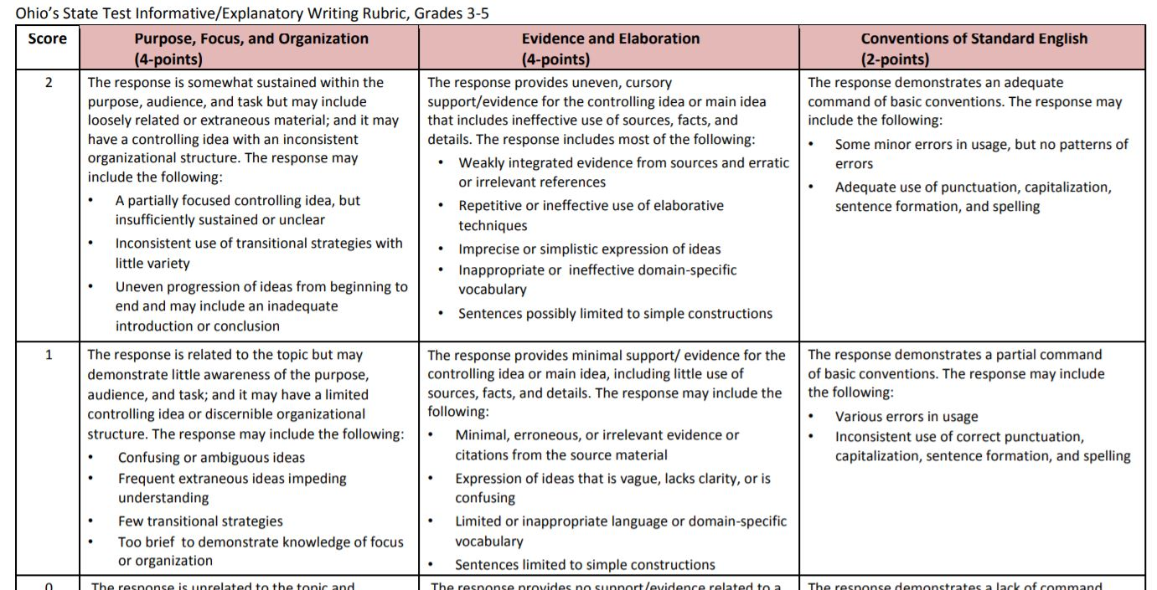

Slide 7
WHAT TOOL CAN BE USED TO HELP OUR SCHOLARS?

Slide 8
Painted Paragraph Graphic

Slide 9
Painted Essay Graphic 4-8

Slide 10
Getting to Know Painted Essay Video
https://www.youtube.com/watch?v=EuAucDKndwk

Slide 11
Paragraph Format

Slide 12
Focus Question
FOCUSING QUESTION: What makes America diverse?
FOCUS STATEMENT : Many things make America diverse.

Slide 13
2nd Grade Informational Paragraph
Topic/Subject/Text
America is Diverse/Social Studies/ America is.. by Louise Borden
Central Ideas
Content Standard: U.S. Regional Studies
CC Reading Standard:
R1.2.6: Identify the main purpose of a text, including what the author wants to answer, explain, or describe.

Slide 14
Reading Drives Writing
CC Writing Standard:
W.2.8: Recall information from experiences or gather information from provided sources to answer a question.
W.2.2 Write informative/explanatory texts in which they introduce a topic, use facts and definitions to develop points, and provide a concluding statement or section

Slide 15
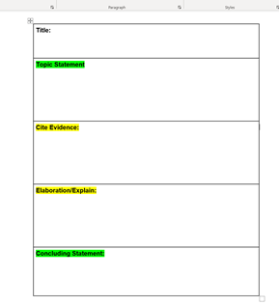

Slide 16
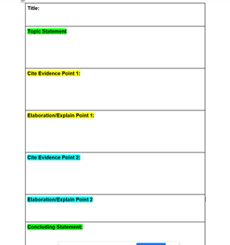

Slide 17
Painted Paragraph FOCUSING QUESTION: What makes America diverse? U
There are many things that make America diverse. The people in America are diverse because there are many different kinds of people in America. There are farmers who work to grow our crops. There are factory workers, school teachers and artists and bankers. We even have cowboys in America! America has 50 states. Many have big cities with tall skyscrapers. Some have small towns with country roads. America also has many landforms including hot and dry deserts in the west, swamps and bayous in the south and tall snow capped mountains. The diverse people and places in America help to make it a very special place.

Slide 18
Painted Essay Graphic

Slide 19
Blank Essay Graphic Organizer

Slide 20
Focus Question 3rd grade example

Slide 21
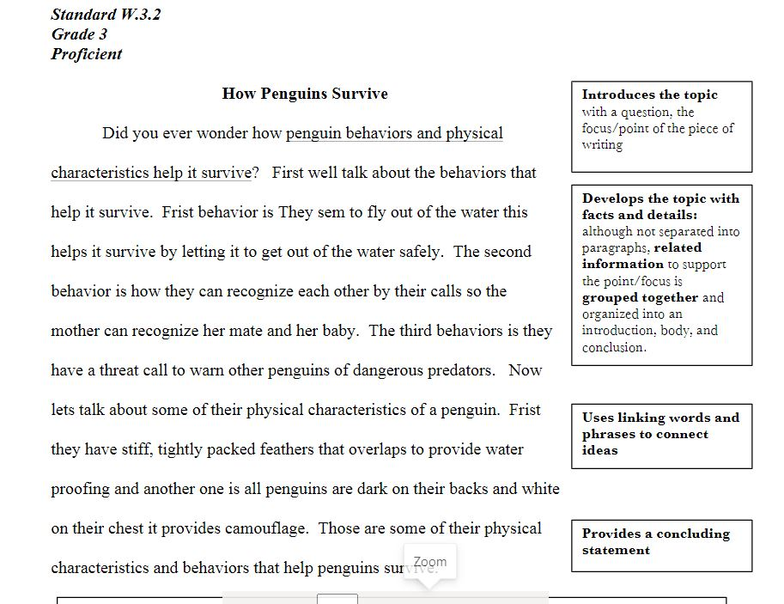

Slide 23
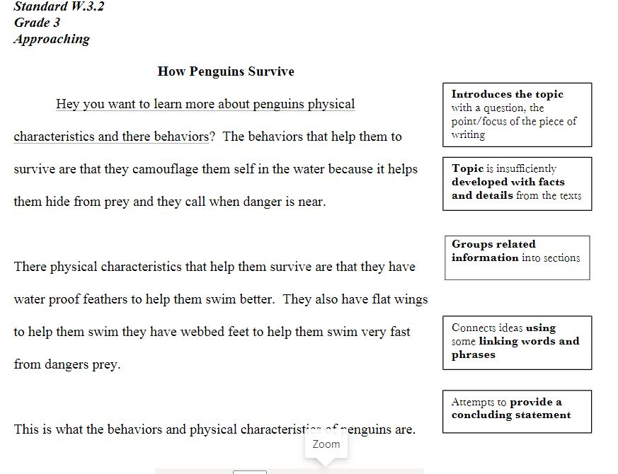

Slide 24
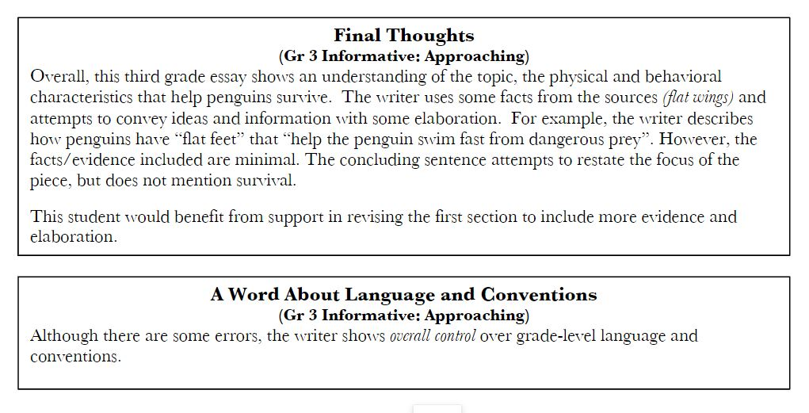

Slide 25
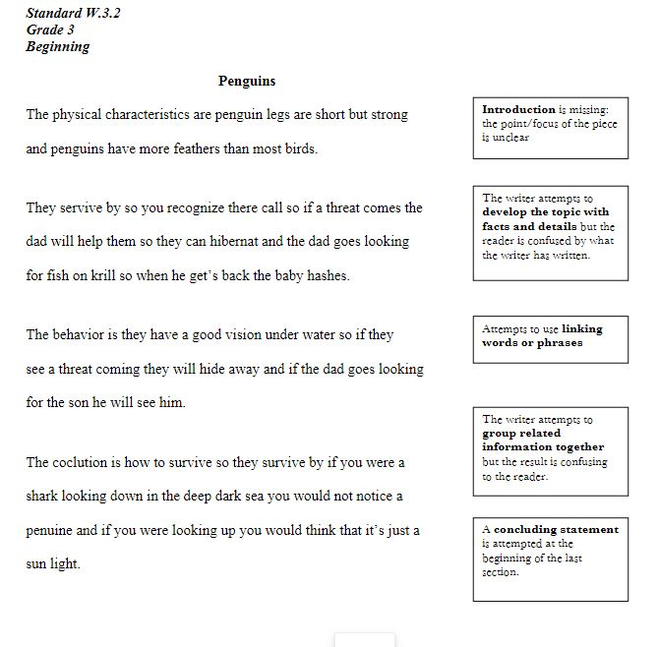

Slide 27
Writing will happen utilizing:
School Platforms
Seesaw
Schoology

Slide 28
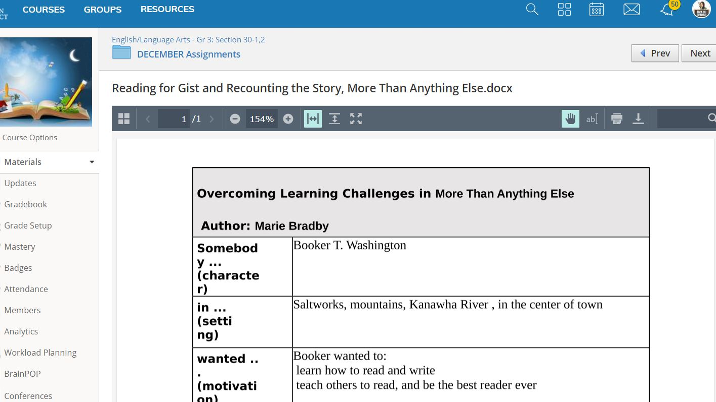
Example from Schoology platform
Students grades 3-8 use this platform to enter writing

Slide 29
Example from Seesaw k-3

Slide 30
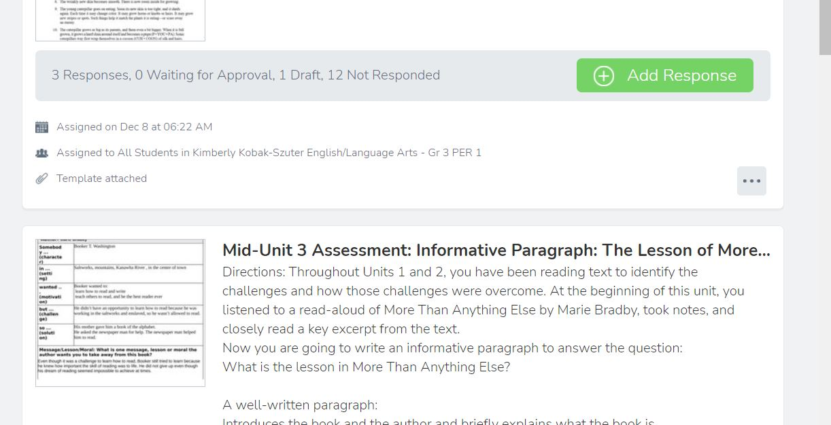

Slide 32
Organization is Key
Students should:
Sitting at a desk or in a chair
Students should have pencils, papers, graphic organizer in one space
Solution: School Purchased Laptop Bookbags with compartments to help hold and organize school materials.

Slide 33
Organizational Tool
5.6” LAPTOP BACKPACK
Laptop backpack with padded back and padded straps.
The main compartment has a padded slot for up to a 15.6" computer notebook and organizing inner pockets besides a pocket for protection of IDs
This tech bag also has another smaller front pocket.

Slide 34
Thank you for attending!
Wrap-up:
Questions?
Backpack/Materials Pick-up
Raffle Winner!

